Slide 1


CO1035: Game Concepts
Lecture 1A
Introduction to the Module

Slide 2
Introduction
The module material was originally developed
  Gareth Bellaby, Laurent Noel, Nick Mitchell, and Misbahu Zubair.
Lectures and Labs will be run by Aimilios Hadjiliasi.
Contact:
  Via Email: ahadjiliasi1@uclan.ac.uk

Slide 3
Module Content
The module is separated into four thematic areas:
  The computer game industry: Commercial game design and development, sales, rating, censorship, etc.
  Game Mechanics: Gameplay, Game Balance, etc.
  Game Development Concepts: Game loop, User Input, Collision Detection, etc.
  Mathematics for Game Development: Trigonometry, Vectors, Matrices, etc.

Slide 4
Learning Objectives
On successful completion of this module, you will be able to:
  Describe key game concepts.
  Critique a game design with reference to published games.
  Use a game engine to create a simple computer game prototype.
  Apply mathematical techniques for analysis and reasoning about problems

Slide 5
Why study Games Dev?
Proven track record of graduate entry into the games industry.
We are one of the few degrees with a computer game dev specialisation that supports immersive learning using Virtual and Augmented Reality.
Our students participate in local, national, and international competitions with great success!
Accredited by BCS and ETEK to the highest level possible
Mirrors industry needs and composition. Training of programmers for the games ind6stry.
Learning important game concepts, Maths, AI, 3D graphics, etc
Content is designed and delivered by experienced staff across the UK and Cyprus campuses.
Follows guidelines established by the International Games Developers Association (IGDA).
We now have our own Games Studio!

Slide 6
Rays and Vectors Game Studio
The 1st and only student-led Game Studio in Cyprus
  Led and managed by students
  Located at the InSPIRE lab
Simulating workplace conditions
  Job-specific requirements
  Reporting to the Studio Manager and Director
  Students rotate through roles
  Covering important aspects, starting from Concept Development, NDA… Gold Master release
  Semester-long and long-term projects
  Indie and Team Projects
If you are interested in game development, join our Rays and Vectors Game Studio Discord channel: https://discord.gg/RYHc5x4Sv

Slide 7
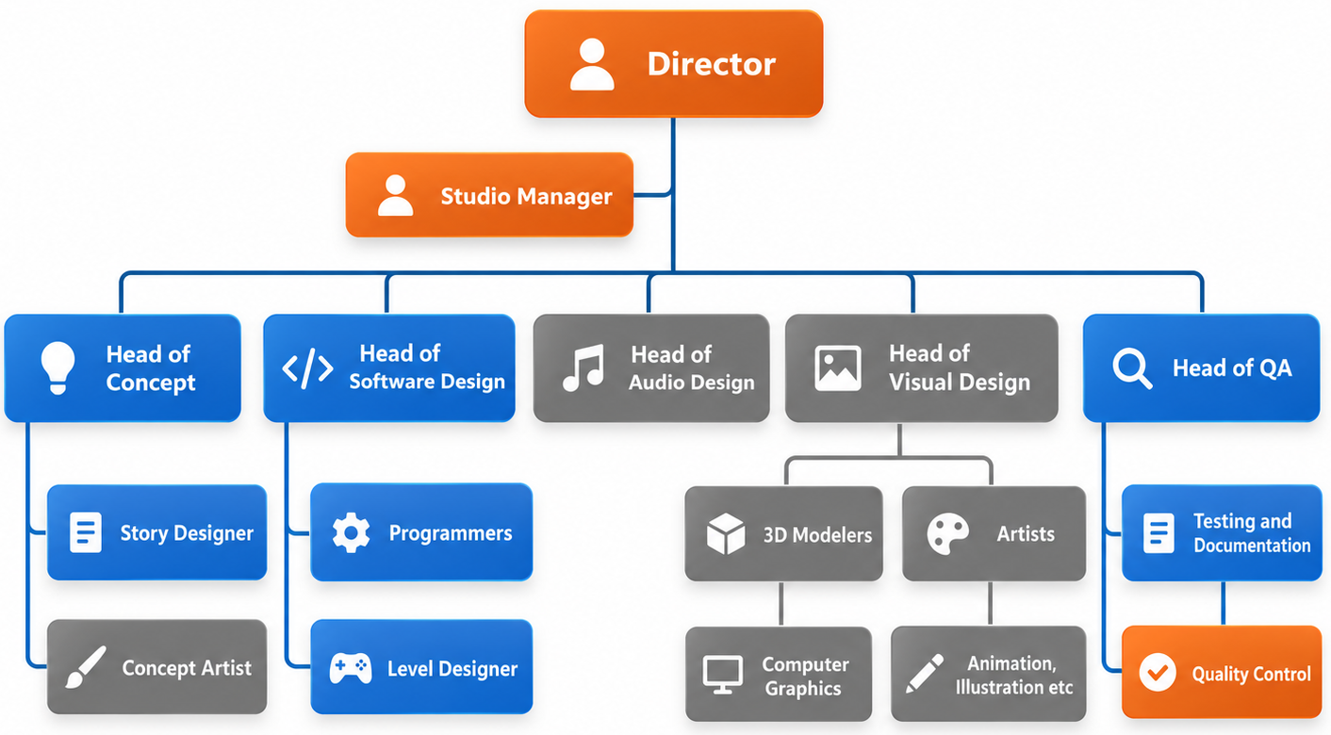
Rays and Vectors Organizational Structure

Slide 8
Module Delivery
Lectures: 2h lectures that will cover the theoretical aspects of games
Labs: 3h lab sessions that focus on programming and implementing game development.
Additional Materials: periodically, additional materials in the form of YouTube videos, LinkedIn Learning courses, Tutorial Videos, Websites, Magazines, etc.

Slide 9
Labs
You will be using C++ to write code for a game engine specifically built at UCLan to teach game programming, the TL-Engine.
You will find the TL-Engine installed on the lab computers you will be working on.
Each lab has mandatory exercises for you to complete.
Most labs also have additional exercises for you to complete either in the lab or in your own time (optional).
Completing these exercises will put you in a very good position to excel in this module and in all your programming endeavors.

Slide 10
Working at Home
You will need to install the TL-Engine and Visual Studio on your PC to be able to participate in remote labs.
You need to have a Windows PC to be able to install it.
  If you are a MAC user, you will need a Virtual Machine to run Windows.
Instructions to help you through installing the TL-Engine are available on Blackboard.

Slide 11
Blackboard Space
All materials for this module will be made available through the module’s
Blackboard space.
Announcements for the module will be made through Blackboard.
Additional materials may be added during the week, e.g., lecture recordings.
You should be checking Blackboard regularly for updates.

Slide 12

BUT: Currently, BB space is not available..!!

Slide 13
Module Assessment
2 Programming Assignments
  Assignment 1 weights for 40%
  Assignment 2 weights for 60%

Slide 14
Best Practices
Attend all lectures and labs.
Complete all lab exercises.
Practice programming in your own time.
ASK FOR HELP YOU STRUGEELING. WE ARE HERE TO HELP!

Slide 15
Questions?!

